Slide 1
Freedom of speech
Introduction to Philosophy
Philosophy 100
Class 19

Slide 2
Overview
When, if ever, is it morally permissible to prevent or suppress someone’s opinion, speech, or self-expression?
What is hate speech?
Does hate speech differ from offensive speech?
Should we censure people who willfully spread falsehoods?

Slide 3
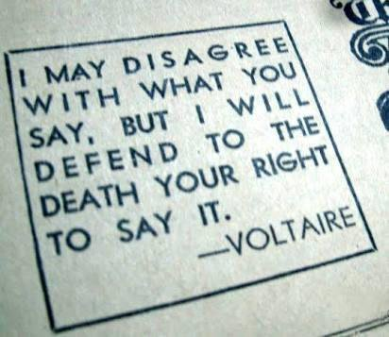
Traditional Liberal Democratic View
The freedom of expression is vital.
All citizens have a right to freedom of thought, opinion, and speech.

Slide 4
Considerations Challenging the Liberal View
Value-Based
Veridic-Based
Offensive speech
Pornography
Crass, crude, or derogatory speech
Hate speech
Abusive, threatening, or harmful speech on the basis of prejudice
Willfully misleading speech
Propaganda
Fake News
Bullshit

Slide 5
On Liberty
John Stuart Mill
(1859)

Slide 6
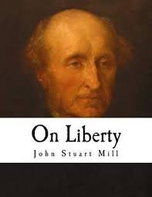
Mill’s Liberties
Freedom of Thought, Opinion, and Speech
Freedom of Pursuits
Freedom of Assembly
“No society in which these liberties are not…respected is free”

Slide 7
Mill’s Defense of Free Speech
Any opinion might be true—to think otherwise is to assume our own infallibility.
Even false opinions may contain elements of truth. It is only to collusion of adverse opinions that the remainder of the truth has any chance of being supplied.
Even if the opinion is whole truth, unless it survives vigorous opposition, it will not be held on rational grounds.
The unchallenged opinion, even if wholly true, will become a simple formal profession, infectious for good, and preventing any real conviction.

Slide 8
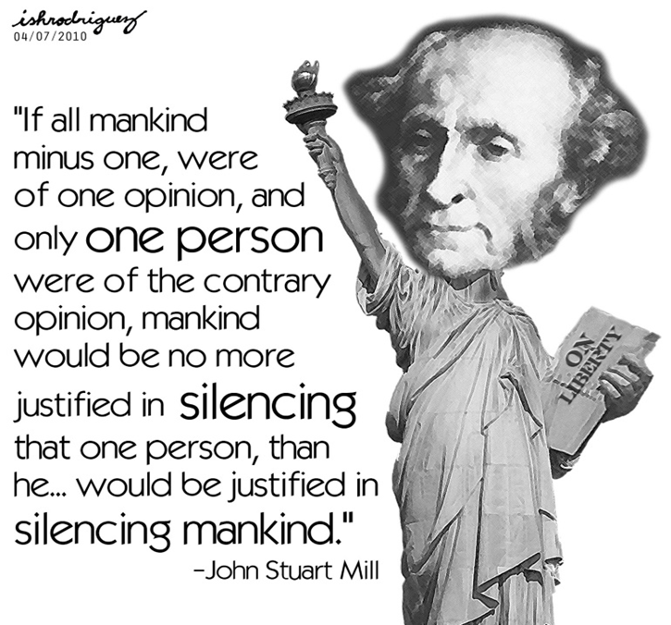

Slide 9
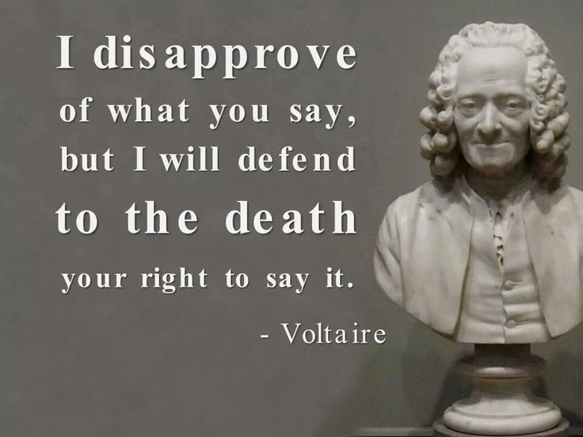
Our well being as a species is contingent on being able to openly and freely discuss ideas.
Do we learn more from those with whom we already agree and those with whom we disagree?

Slide 10
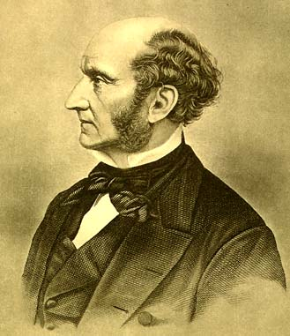
Harm and Freedom
We can define freedom as the pursuit of one’s own good in one’s own way, provided this does not infringe on others’ efforts to do the same.
Freedom enhances everyone’s well-being, including freedom of thought and expression.
The harm principle: The only reason a group or an individual is justified in curtailing another’s liberty is to prevent harm to others.

Slide 11
How should we understand harm?
Mill’s Harm Principle: the risk of harming another is the only legitimate legal restraint of an activity.
Exclusions:
Paternalism
Moralism
Harm:
The threat of physical harm and violence. The prevention of me enacting my own liberties.
Not something that is offensive. Merely being offended is simply a nuisance and not a harm.

Slide 12
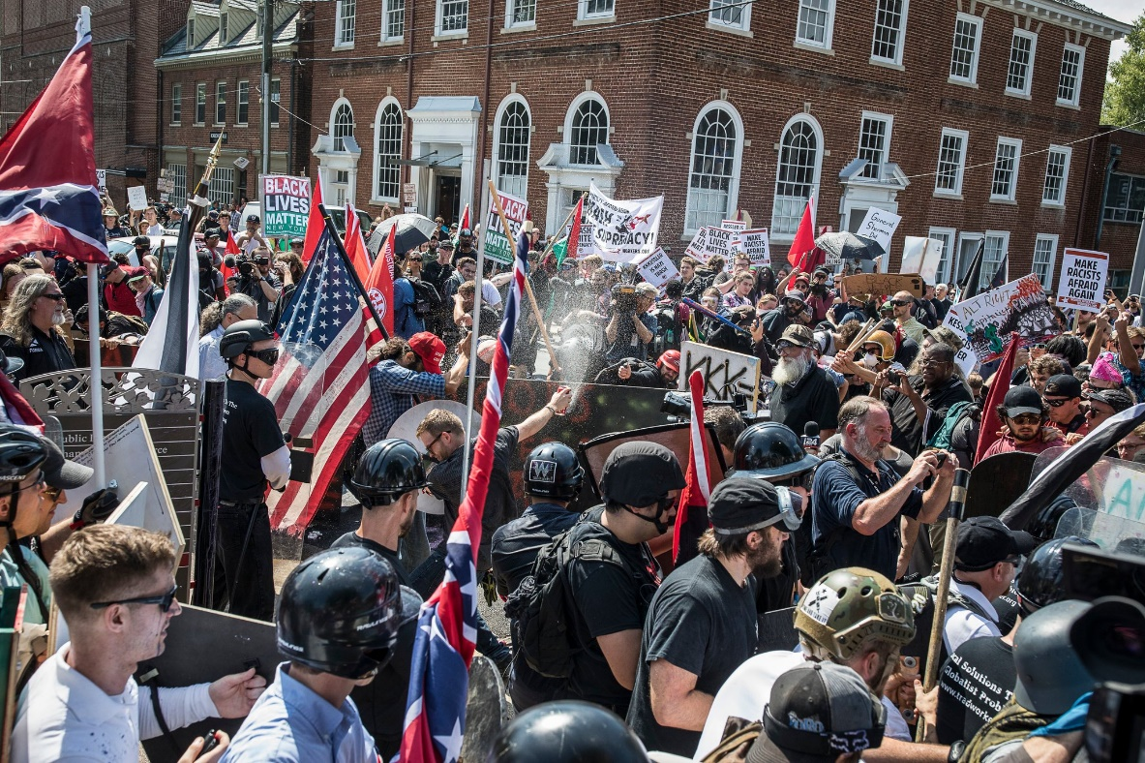
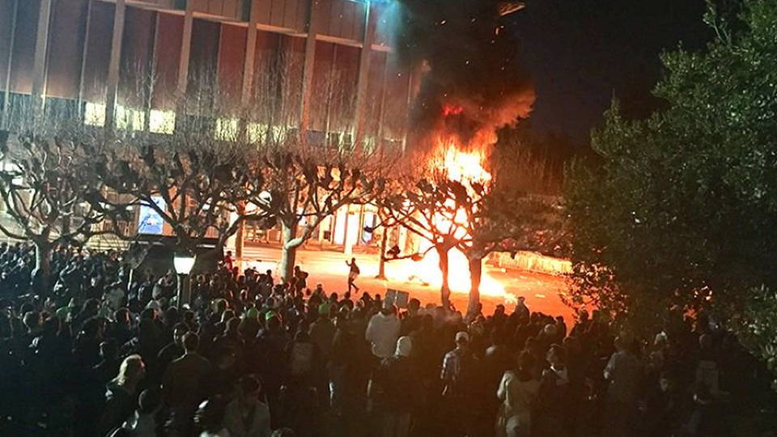
Alt-right (neo-Nazi) rally in
North Carolina, 2017.
Student protest against that Milo dude at Berkeley in 2017.

Slide 13


Slide 14
Social Justice, Oppression, and Free Speech
If the liberal ideal is that no liberty can be suppressed except in violation of the harm principle, what are we to make of today’s reactions to “hate speech,” triggers, and micro-aggressions?
Consider this question in light of Mill’s defense of liberty—specifically concerning freedom of thought and speech.

